Slide 1
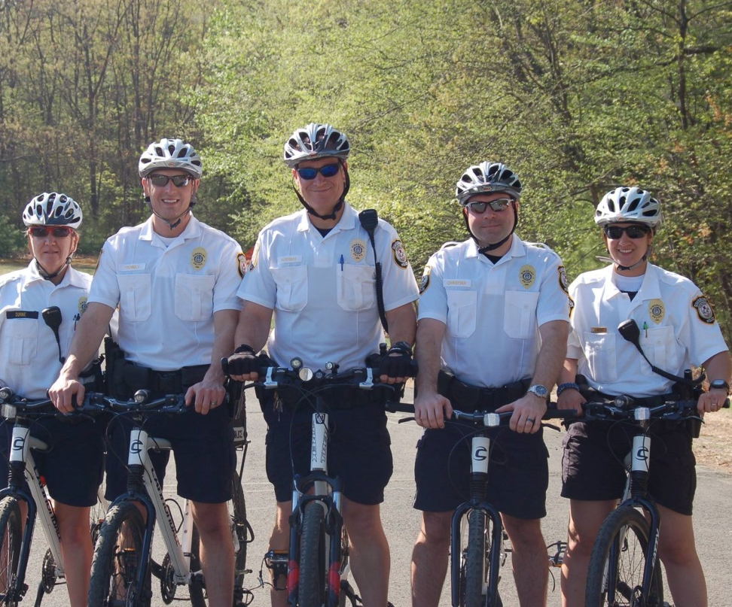
Bicycle & Motorist Safety Spring 2018
Pfc. Lauren Devin
Simsbury Police Department

Slide 2

Share the Road
Driving on a public roadway requires attention and courtesy whether you are on a bike or in a car.
BICYCLISTS must obey all traffic laws and should ride predictably.
DRIVERS must also obey all traffic laws and should be alert.

Slide 3
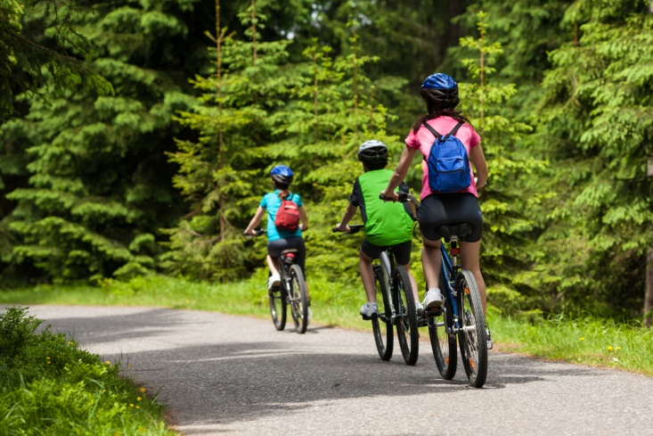
Cycling on the Road
Cyclists must ride WITH traffic and are to ride are near the right side of the roadway as is safe.
Riding two abreast is permitted as long as it does not impede with normal and reasonable movement of traffic.

Slide 4
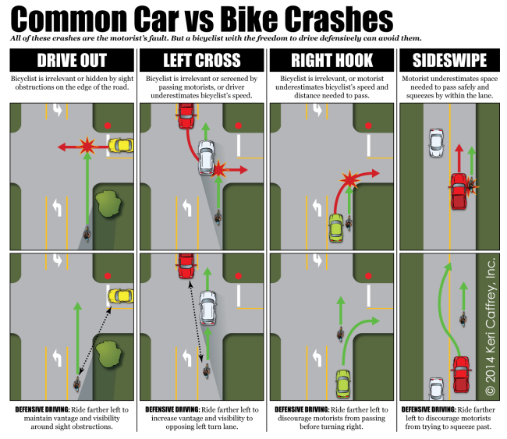

Slide 5
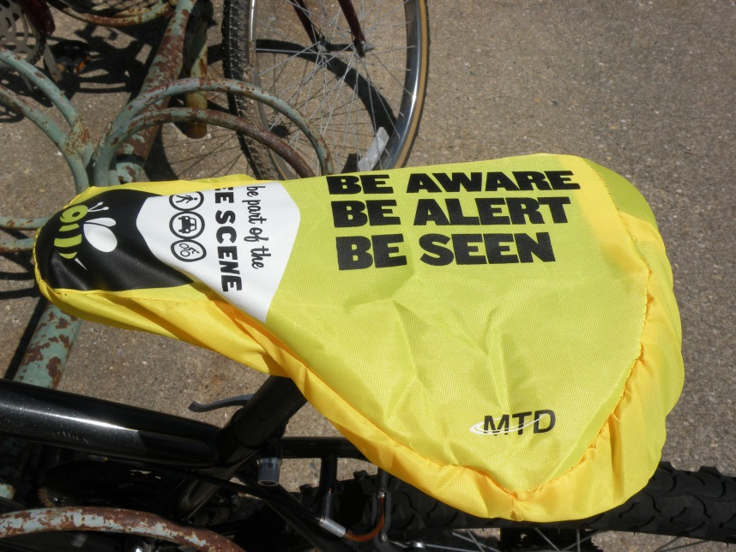
BE ALERT!
Watch for potential hazards (potholes, drains, debris, open car doors, etc.)
Scan the road at least 100 feet ahead.
Allow time to maneuver around these hazards and negotiate traffic

Slide 6
Ride Predictably
Ride in a straight line.
Don’t swerve in and out of traffic or between parked cars.
Check for traffic before entering the street or intersection.
Anticipate hazards and adjust your position.

Slide 7
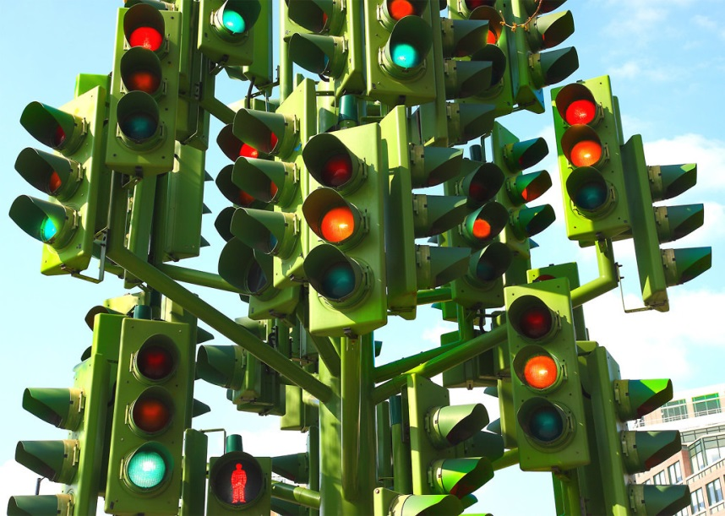
Signal all Turns
Look back before you make a lane change or turn.
Signal safely in advance using the proper hand signal.
When making a left turn, proceed as a vehicle would by moving into the left side of the travel OR cross like a pedestrian (off your bike) at a marked crosswalk.

Slide 8
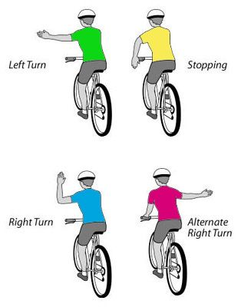
Bicycle Hand Signals

Slide 9
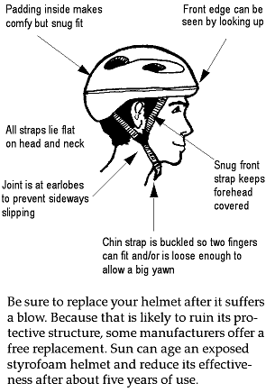
Proper Helmet Fit

Slide 10

Motorists
Bicycles are less visible so always be aware of bicyclists that MAY be on the road.
Reduce your speed when passing bicycles.
Expect the unexpected around curves and over hills where visibility ahead is limited.

Slide 11
In the Roadway….
Avoid distracted driving, aggressive driving, and driving under the influence of alcohol or drugs.
Mind the door zone! Check for approaching cyclists before opening your car door.
Be vigilant at intersections. Look for cyclists and always indicate your intention to turn using your turn signals.
Connecticut Law requires a fine up to $1,000 on careless drivers who cause the death or serious injury of a cyclist or other vulnerable user.

Slide 12
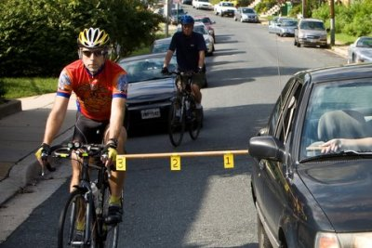
Passing a Bicyclist
Give at least 3 feet of passing space.
After passing be sure you have allowed enough room between you and the cyclist before moving back into the lane.
When turning left, yield to oncoming bicyclists just as you would a vehicle.

Slide 13
Share the Road
Be considerate in bad weather and provide extra room.
When uncertain in any situation, SLOW DOWN until it is safe to pass.
Bicyclists may be unpredictable so expect the unexpected.
Always take the safest approach.

Slide 14

When we all drive safely, have patience, and are considerate of one another; its easy to SHARE THE ROAD!

